Slide 1





Wanderlust: a personalized travel planning and tracking app
Presented by Sathish

Slide 2
Description
Wanderlust is an innovative travel companion app that simplifies planning, enhances exploration, and fosters connection. This user-friendly platform tailors travel experiences to individual preferences, ensuring unforgettable adventures.

Slide 3
Java Program
Here's a simplified Java program for Wanderlust, a personalized travel planning and tracking app. This example focuses on core features and serves as a starting point for further development.
*Wanderlust.java*
```
import java.util.ArrayList;
import java.util.List;
import java.util.Scanner;
class Destination {
String name;
String description;
String location;

Slide 4
Public Destination(String name, String description, String location) {
this.name = name;
this.description = description;
this.location = location;
}
}
class Trip {
String name;
String startDate;
String endDate;
List<Destination> destinations;
public Trip(String name, String startDate, String endDate)

Slide 5
this.name = name;
this.startDate = startDate;
this.endDate = endDate;
this.destinations = new ArrayList<>();
}
public void addDestination(Destination destination) {
destinations.add(destination);
}
}
class User {
String name;
List<Trip> trips;
public User(String name) {
this.name = name;
this.trips = new ArrayList<>();
}

Slide 6
Public void addTrip(Trip trip) {
trips.add(trip);
}
}
public class Wanderlust {
static List<User> users = new ArrayList<>();
static Scanner scanner = new ScSystem.scanner(System.in);
public static void main(String[] args) {
while (true) {
System.out.println("Wanderlust Travel App");
System.out.println("1. Register");
System.out.println("2. Login");
System.out.println("3. Exit");
int choice = scanner.nextInt();
scanner.nextLine(); // Consume newline left-
over

Slide 7
switch (choice)
{
case 1:
registerUser();
break;
case 2:
loginUser();
break;
case 3:
System.exit(0);
break;
default:
System.out.println("Invalid choice");
}
}
}

Slide 8
Private static void registerUser() {
System.out.print("Enter name: ");
String name = scanner.nextLine();
User user = new User(name);
users.add(user);
System.out.println("Registration successful!");
}
private static void loginUser() {
System.out.print("Enter name: ");
String name = scanner.nextLine();
User user = findUserByName(name);
if (user != null) {
System.out.println("Login successful!");
tripPlanningMenu(user);
}

Slide 9
else {
System.out.println("User not found");
}
}
private static User findUserByName(String name) {
for (User user : users) {
if (user.name.equals(name)) {
return user;
}
}
return null;
}
private static void tripPlanningMenu(User user) {
while (true) {

Slide 10
System.out.println("Trip Planning Menu");
System.out.println("1. Create Trip");
System.out.println("2. View Trips");
System.out.println("3. Exit");
int choice = scanner.nextInt();
scanner.nextLine(); // Consume newline left-over
switch (choice)
{
case 1:
createTrip(user);
break;
case 2:
viewTrips(user);
break;
case 3:
return;

Slide 11
default:
System.out.println("Invalid choice");
}
}
}
private static void createTrip(User user)
{
System.out.print("Enter trip name: ");
String tripName = scanner.nextLine();
System.out.print("Enter start date: ");
String startDate = scanner.nextLine();
System.out.print("Enter end date: ");
String endDate = scanner.nextL
ine();

Slide 12
Trip trip = new Trip(tripName, startDate, endDate);
user.addTrip(trip);
System.out.println("Trip created successfully!");
}
private static void viewTrips(User user) {
System.out.println("Your Trips:");
for (Trip trip : user.trips) {
System.out.println(trip.name);
}
}
}

Slide 13
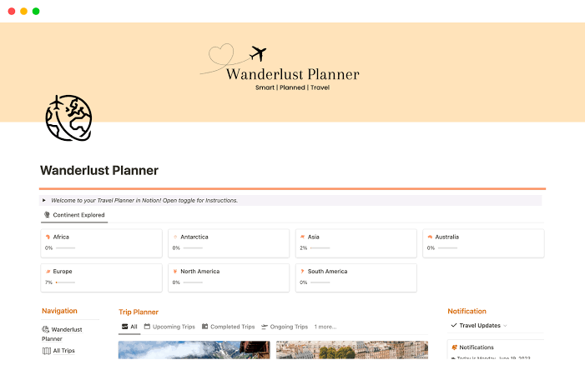
Output :

Slide 14


Slide 15
Conclusion :
Wanderlust is a revolutionary travel companion app that simplifies planning, enhances exploration, and fosters connection. By tailoring travel experiences to individual preferences, Wanderlust ensures that every journey is a memorable one. With its user-friendly interface, expert-curated destination guides, and real-time tracking features, Wanderlust is the ultimate travel app for adventurers worldwide.

